Slide 1
CRM SALES FORCE
REPORT ANALYSIS

Slide 2
INTRODUCTION
Salesforce CRM, commonly known as Salesforce, is a cloud-based customer relationship management (CRM) platform. CRM refers to a set of strategies, practices, and technologies used by businesses to manage and analyze customer interactions and data throughout the customer lifecycle.
Salesforce CRM provides companies with a centralized platform to store and manage customer information, track sales activities, automate marketing campaigns, and enhance customer service. It enables businesses to streamline their sales processes, improve lead generation and conversion rates, and ultimately drive revenue growth.

Slide 3
Key features of Salesforce CRM include:
Contact and Account Management: Salesforce allows businesses to store and organize customer contact details, account information, and interaction history in a single database. This enables sales teams to have a comprehensive view of each customer and their engagement with the company.
Opportunity Management: Salesforce helps businesses track and manage sales opportunities from the initial lead stage to closing deals. It provides tools for sales forecasting, pipeline management, and collaboration among team members.
Sales Analytics: The platform offers reporting and analytics capabilities to gain insights into sales performance, track key metrics, and identify trends and patterns. Sales managers can monitor individual and team progress, identify bottlenecks, and make data-driven decisions.
Marketing Automation: Salesforce includes features for automating marketing campaigns, lead nurturing, and email marketing. It allows businesses to create targeted marketing campaigns, track campaign effectiveness, and integrate with other marketing tools.
Customer Service and Support: Salesforce provides tools for managing customer support inquiries, case resolution, and service-level agreements. It helps businesses streamline their support processes, improve response times, and enhance customer satisfaction.
Mobile Access: Salesforce offers mobile apps for iOS and Android devices, enabling sales and service teams to access customer data, manage tasks, and collaborate on the go.
Salesforce CRM is highly customizable and scalable, allowing businesses to adapt it to their specific needs. It offers a wide range of additional features and integrations through its AppExchange marketplace, where users can find third-party applications to extend the functionality of Salesforce.
Overall, Salesforce CRM is a popular and widely used solution for managing customer relationships and driving sales growth across industries.

Slide 4
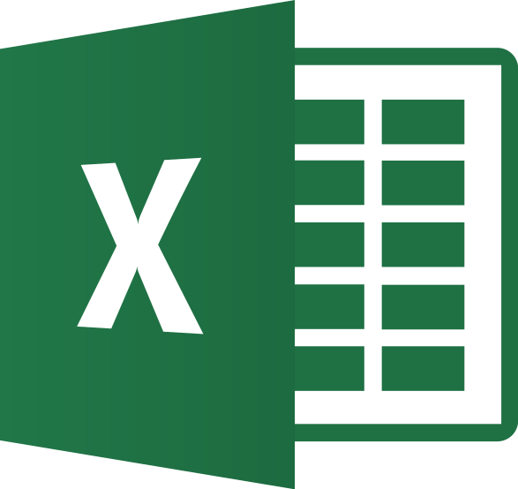

TOOLS USED
EXCEL
TABLEAU

Slide 5
Opportunity(KPIs)
Expected Amount
Active Opportunities
Conversion Rate
Win Rate
Loss
Trend Analysis
Running Total Expected Vs Commit Forecast Amount over Time
Running Total Active Vs Total Opportunities over Time
Closed Won Vs Total Opportunities over Time
Closed Won vs Total Closed over Time
Expected Amount by Opportunity Type
Opportunities by Industry

Slide 6
Lead(KPIs)
Total Lead
Expected Amount from Converted Leads
Conversion Rate
Converted Accounts
Converted Opportunities
Lead By Source
Lead By industry

Slide 7
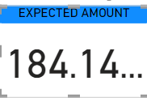
KPI 1
EXPECTED AMOUNT

Slide 8
KPI
ACTIVE OPPORTUNITIES
ACTIVE OPPORTUNITIES
1272
CONVERSION RATE
Conversion Rate
10.33%
WIN RATE
31.06%
WIN RATE

Slide 9
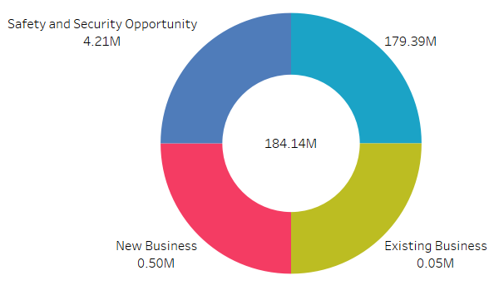
KPI
LOSS
EXPECTED AMOUNT BY
OPPORTUNITY TYPE
LOSS
1.93K

Slide 10
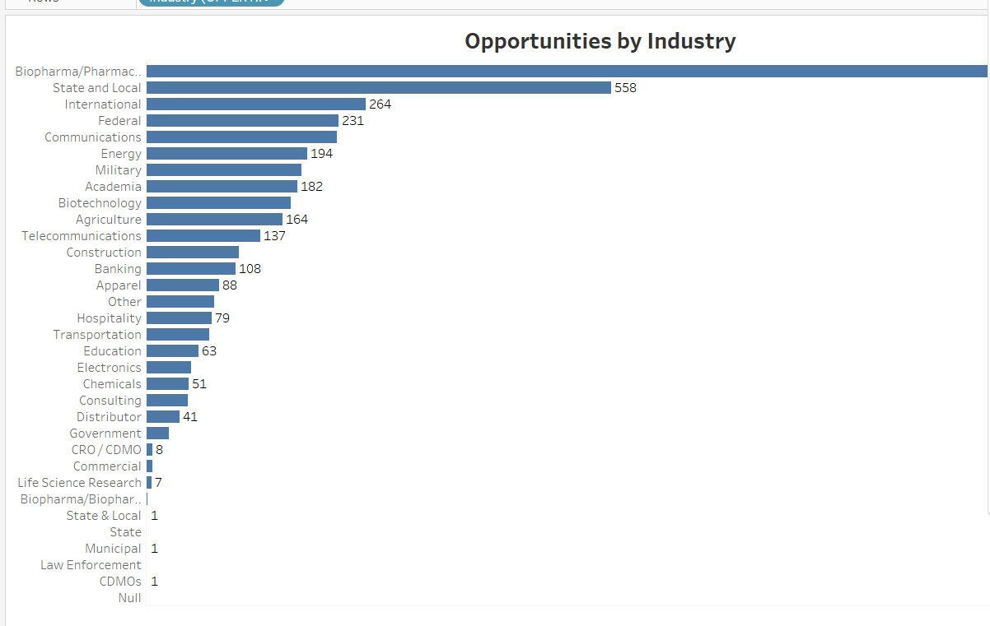
KPI
OPPORTUNITIES BY INDUSTRY

Slide 11
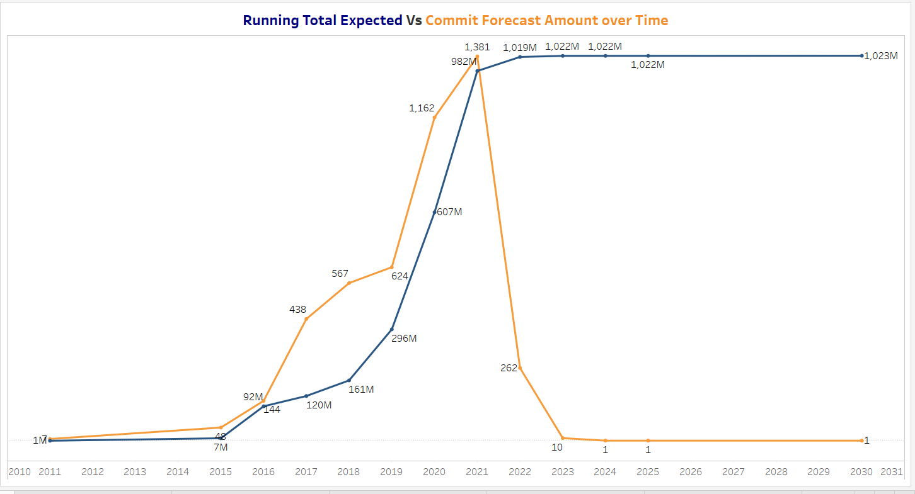
TREND ANALYSIS
Running Total Expected VS Commit Forecast Amount over time

Slide 12
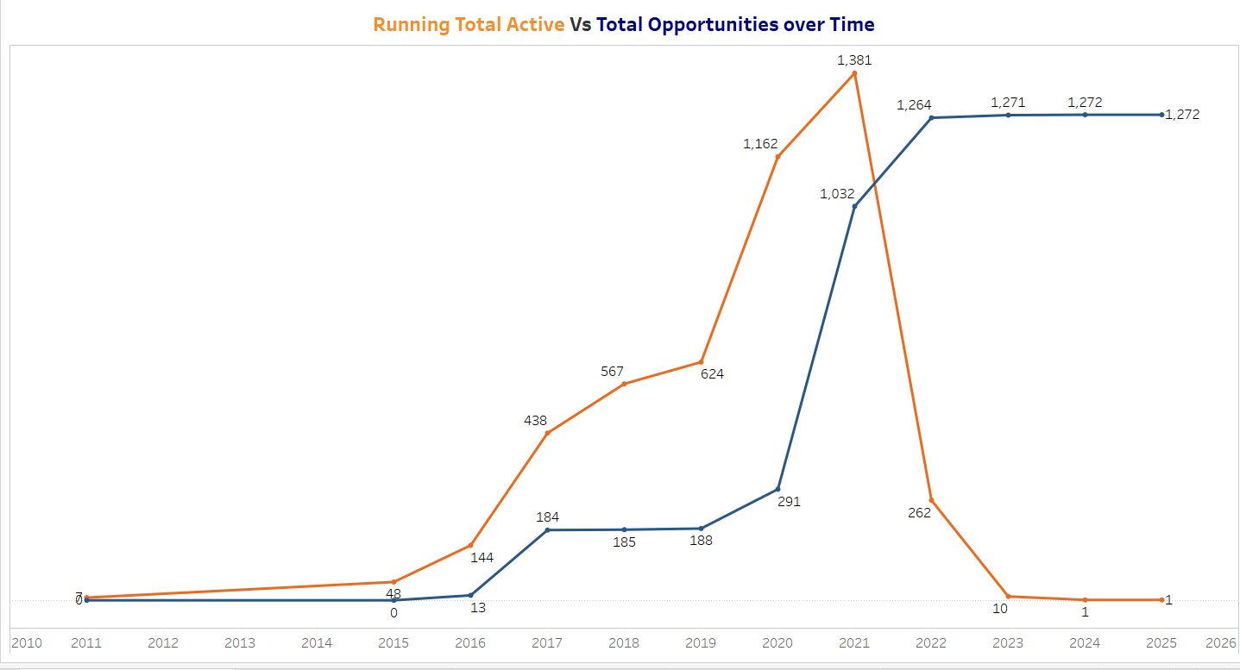
Running Total Active Vs Total Opportunities Over Time

Slide 13
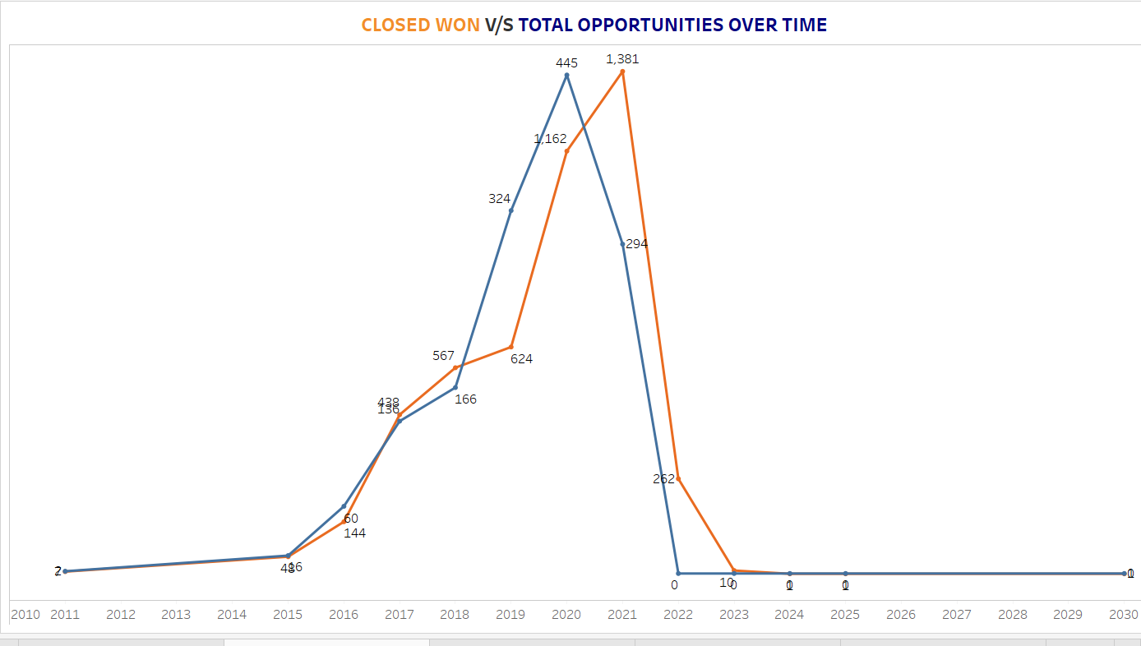
Closed Won Vs Total Opportunities Over Time

Slide 14
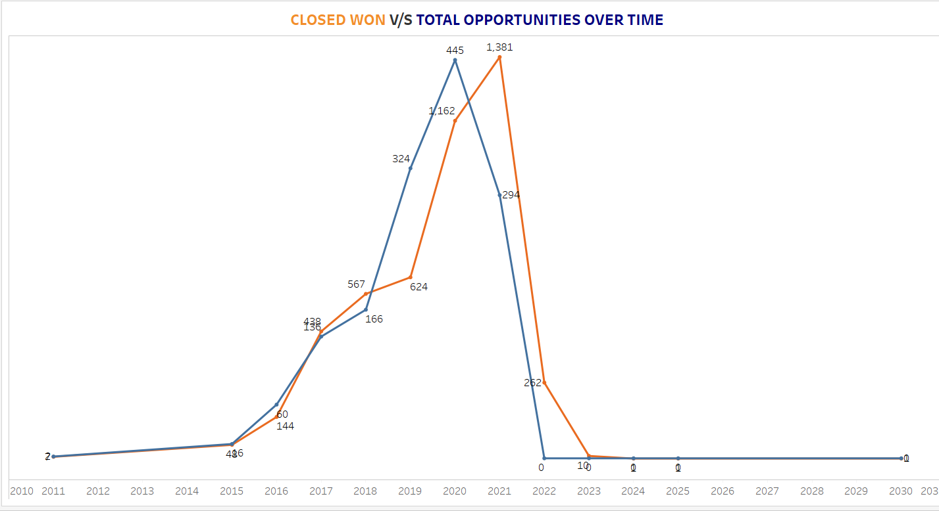
Closed Won Vs Total Closed Over Time

Slide 15
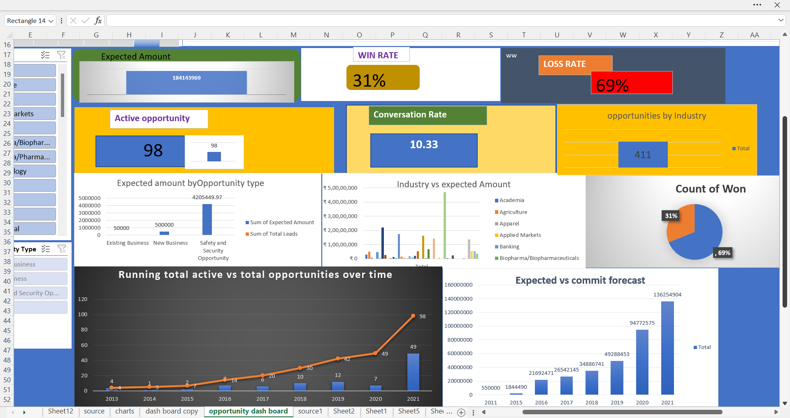
OPPORTUNITY DASH BOARD EXCEL

Slide 16
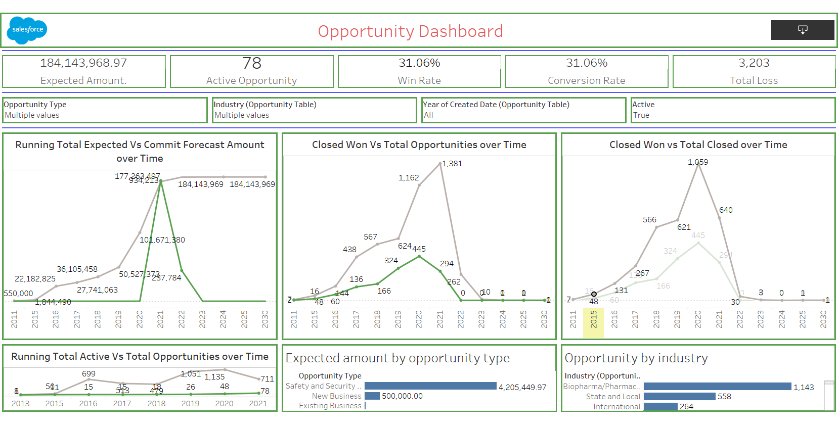
OPPORTUNITY DASH BOARD TABLEAU

Slide 17
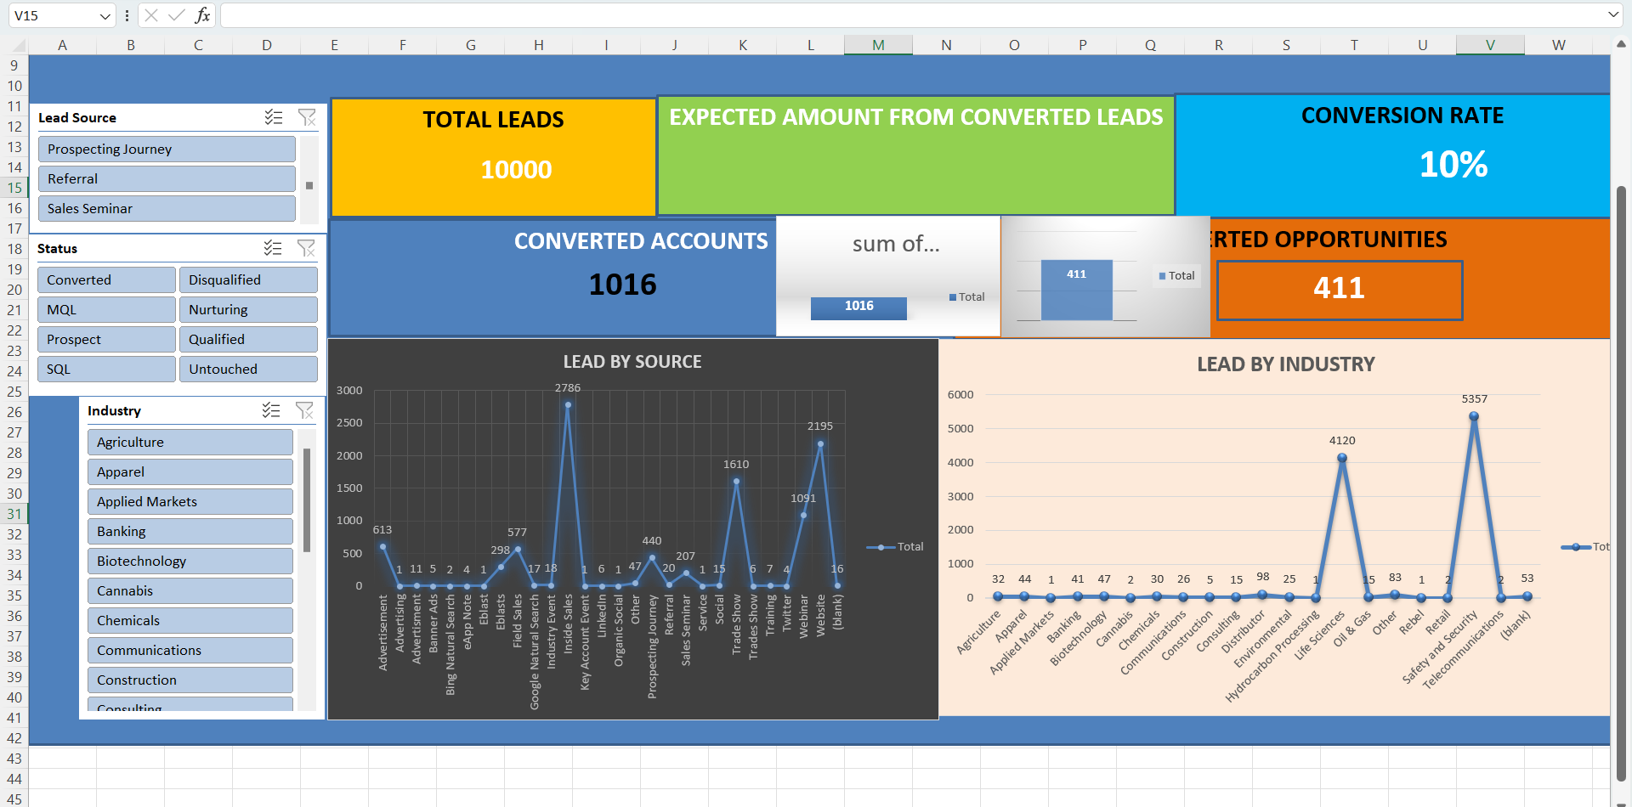
LEAD DASH BOARD EXCEL

Slide 18
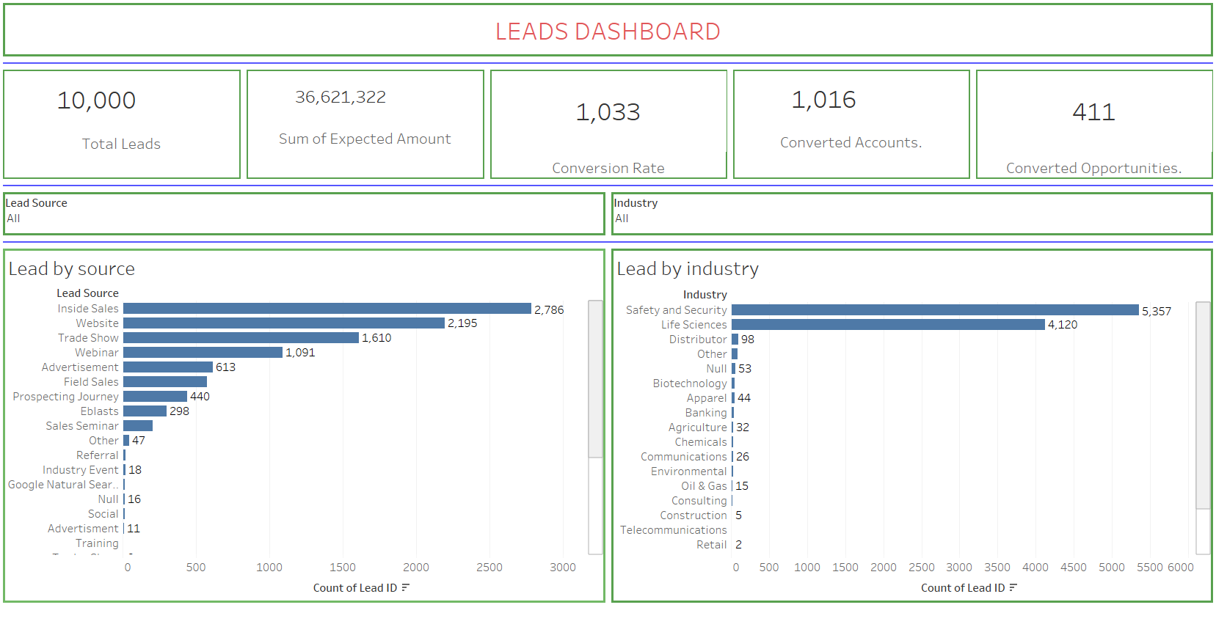
LEAD DASH BOARD TABLEAU

Slide 19
CONCLUSION
Created Dash Board on opportunity table and Lead table
Created reports based on my knowledge using excel ,BI tools Tableau

Slide 20
THANK YOU

